Slide 1
Machine learning
Field of studies that give computers the ability to learn without being explicitly programmed.

Slide 2
Linear Regression
Dependent variable is continuous in nature
Relationship between dependent variable and independent variable is linear in nature.
Types of linear regression
Simple linear regression
Multiple linear regression

Slide 3
Simple linear regression
One independent variable and one dependent variable
Equation----- y=mx+c
M=Slope
C=intercept
Eg-Predicting the salary of a person based on experience

Slide 4
Multiple linear Regression
More than one independent variable
One dependent variable
Equation---- Y = c + m1x1 + m2x2+ m3x3+ ……. Mnxn
Eg…Price prediction based on multiple feature,predicting price of a real estate.

Slide 5
Cost Function
Cost function (or) loss function measures is the difference between the actual output and the predicted output from the model.
Loss function: Used when we refer to the error for a single training example.
Cost function: Used to refer to an average of the loss functions over an entire training dataset.

Slide 6


Types of errors
Mean square error (L2 loss) Mean Absolute Error(L1Loss)

Slide 7
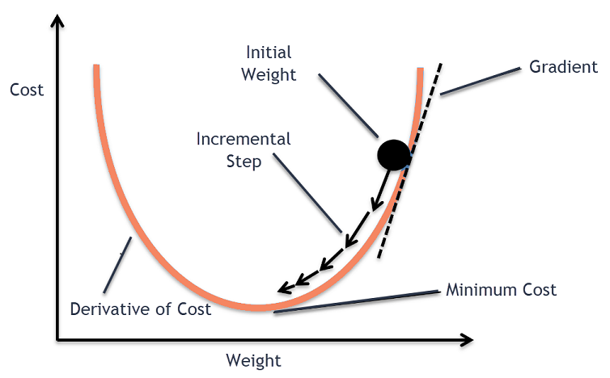
Gradient Descent
Gradient descent is an iterative optimization algorithm for finding the local minimum of a function.

Slide 8
Types of Gradient Descent
Batch Gradient descent
Stochastic Gradient Descent
Mini-Batch Gradient Descent

Slide 9
Batch Gradient Descent
Calculates error for each example within the training dataset but only after all the training examples have been evaluated does the model get updated.
Advantages
It is computational efficient, it produces a stable error gradient and a stable convergence.

Slide 10
Stochastic Gradient Descent
Using single datapoint, where calculate the gradient and update the weights with every iteration.
Advantages
Learning is much faster than BGD
Disadvantages
Fluctuation of cost function occurs due to frequent updation of weights

Slide 11
Mini-Batch Gradient Descent
It simply splits the training dataset into small batches and performs an update for each of those batches.
Advantages
Mini batch gradient descent is widely used and converges faster and is more stable

Slide 12
Logistic Regression
It comes under Supervised learning and it is used to solve classification problems.
The logistic function, also called the sigmoid function.
If the data set is categorical then use logistic regression over linear regression.

Slide 13
Logistic Function
Logistic regression predicts the output of a categorical dependent variable. Therefore the outcome must be a categorical or discrete value. It can be either Yes or No, 0 or 1, true or False, etc. but instead of giving the exact value as 0 and 1, it gives the probabilistic values which lie between 0 and 1.
The sigmoid function is a mathematical function used to map the predicted values to probabilities.
It maps any real value into another value within a range of 0 and 1.

Slide 14
Assumptions of Logistic Regression
The dependent variable must be categorical in nature.
The independent variable should not have multi-collinearity.

Slide 15
Sigmoid Function
Y=1/1+e^-x
X-Independent variable
e-Natural logarithm base

Slide 16
Types of Logistic Regression
On the basis of the categories, Logistic Regression can be classified into three types:
Binomial: In binomial Logistic regression, there can be only two possible types of the dependent variables, such as 0 or 1, Pass or Fail, etc.
Multinomial: In multinomial Logistic regression, there can be 3 or more possible unordered types of the dependent variable, such as "cat", "dogs", or "sheep"
Ordinal: In ordinal Logistic regression, there can be 3 or more possible ordered types of dependent variables, such as "low", "Medium", or "High".

Slide 17
Applications
Customer churn
Criminal detection
AD-click predictions

Slide 18
K-Nearest Neighbors(KNN)
KNN algorithm is simple yet most used classification algorithm. It can also be used for regression.
KNN uses the entire training set, no training is required.
Predictions are made by searching the k similar instances, according to a distance, and summarizing the output.
Also called as lazy algorithm because it is instance based.

Slide 19
(K ) in KNN
The value of k defines the similar neighbors for the new datapoint.
Finding the value of K is not easy as a small value of k means that the noise will have the higher influence on the result and a large value make it expensive. So it is best to run through each possible value of K.
The decision is based on feature similarity.

Slide 20
Steps in KNN
Step 1: Choose a value for K. K should be an odd number.
Step2: Find the distance of the new point to each of the training data.
Step 3:Find the K nearest neighbors to the new data point.
Step 4: For Classification, count the number of data points in each category among the k neighbors. New datapoint will belong to class that has most neighbors.

Slide 21
For Regression the output can be mean , where for classification the output can be the most common class.

Slide 22
Distance in KNN
Euclidean distance is calculated as the square root of the sum of the squared differences between a new point and an existing point across all input attributes.
Other popular distance measures include: 1.Manhattan Distance 2.Hamming Distance 3.Minkowski Distance

Slide 23
Making Predictions
To classify an unlabeled object the distance of this object to the labelled objects is computed, its k-nearest neighbors are identified, and the class label of the majority of nearest neighbors is then used to determine the class label of the object.
For real valued input variable, the most popular measure of distance Euclidean distance is used.

